Slide 1
Convolutional neural network architecture for geometric matching
Ignacio Rocco et.al

Slide 2

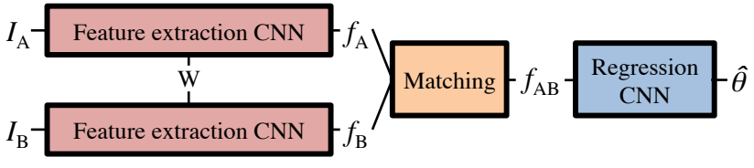
Whole pipeline & Descriptors
A CNN without fully connected layers takes an input image and produces a feature map which can be interpreted as a h × w dense spatial grid of d-dimensional local descriptors.
VGG-16 network, cropped at the pool4 layer (before the ReLU unit), followed by per-feature L2-normalization.
The whole pipeline

Slide 3
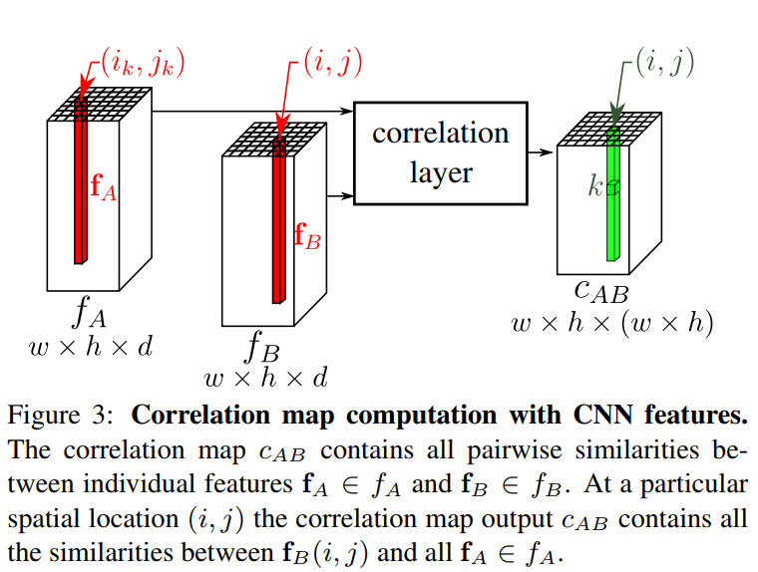

Matching descriptors
For matching, or correlation between the key points in the two input images, the author simply uses dot product. Here the dot product is their cosine distance, since they both are unit vector.
The notation here is a little confusing. Note that the k can stand for every pixel in feature map A. For each pixel in feature map B, the author calculates its distance to all of the pixels in feature map A, then place each distance as k-th element in C_AB(i, j).

Slide 4
Matching descriptors
For matching, or correlation between the key points in the two input images, the author simply uses dot product. Here the dot product is their cosine distance, since they both are unit vector.
The notation here is a little confusing.
Compared to traditional methods, here C_AB is dense matching, not only key points extracted by e.g, harris in the tradional methods.

Slide 5
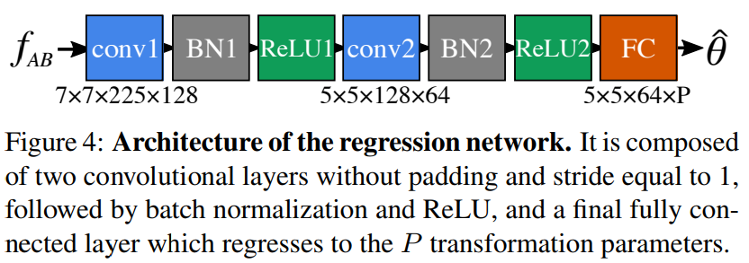
Regress transformation parameters
Regression is performed to get the transformation parameters from image A to image B.

Slide 6

Train
Transform points using parameters θ_groudtruth and hat_θ, and measure the discrepancy between the two transformed grids by summing the squared distances between the corresponding points.
For the points in the image, the author doesn’t uses its original coordinate, but uses a coordinate that image’s center is (0,0), width and height are both 2, sample 21 points along each axis. But I didn’t see any advantage or benefit of this setting.

Slide 7
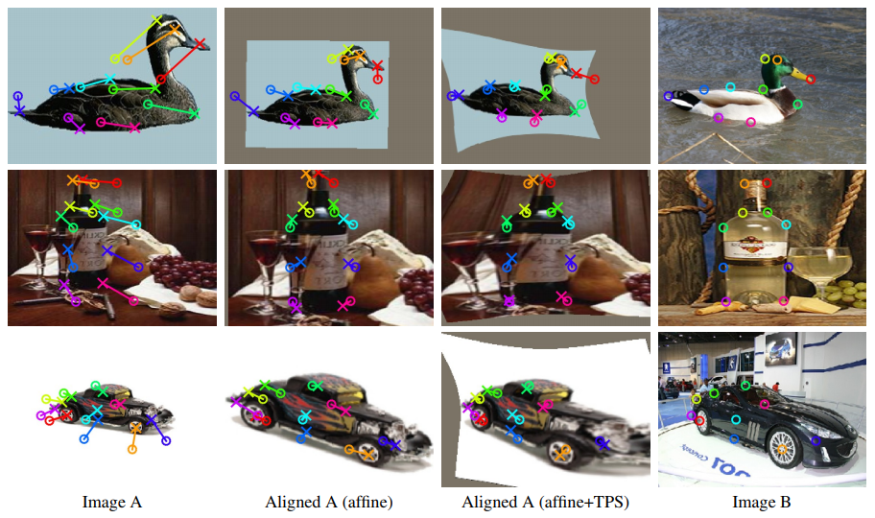
Result
As can be seen here, the matched object can be not the exact same one, but the same category. But I don’t know what can benefit from here.

Slide 8
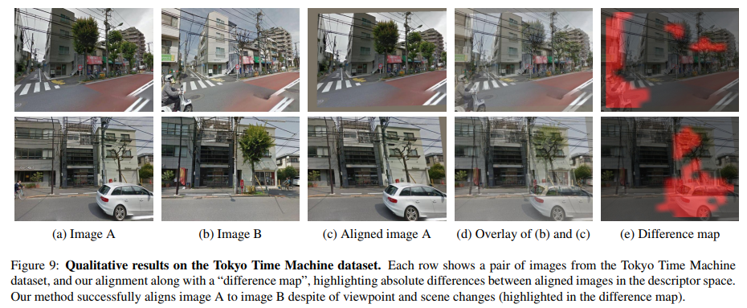
Result

Slide 9
In practice
Pytorch version code: https://github.com/ignacio-rocco/cnngeometric_pytorch
Matconvnet version code: https://github.com/ignacio-rocco/cnngeometric_matconvnet
Highlight: I tried the Pytorch version code with pretrained model, it’s easy to run.
Shortcoming: In the code, image must be resized to (224,224), so I lost resolution drastically.

